Slide 1
Report
TRiO Upward Bound All Staff Hiring / Training
AY- 2014-2015

Slide 2
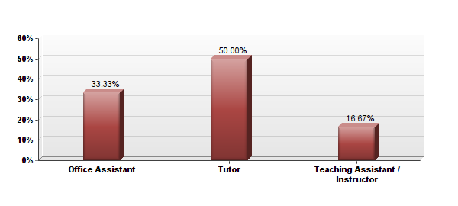
1. Job Position: I am a(n)
# | Answer | Response | %
1 | Office Assistant | 4 | 33%
2 | Tutor | 6 | 50%
3 | Teaching Assistant / Instructor | 2 | 17%
 | Total | 12 | 100%
Notes:
There were 18 present at all staff training (not including the professional staff). Of that 18 only 12 returned their surveys.
The professional staff and volunteer staff were not surveyed.
Out of 12 surveyed a total of 12 responded to the question.
----- Meeting Notes (10/20/14 11:56) -----
its says we had 2
4 were office staff
6 were tutors
2 were teaching staff
total = 12 participants surveyed
----- Meeting Notes (10/20/14 11:56) -----
clarify the enumber of people present - According to how they self selected 4 of the 5 office assistants responed.
2 of the 3-teaching staff responded.
Another thing to consider is that some employees serve dual postions.
RECOMMENDATION: Moving forward we might want to reconsider how we classify and capture those participants data. Also should have a better system of checks and balances to make sure that people are returning their surveys while keeping the survey anonymous.

Slide 3
ALL STAFF HIRING

Slide 4
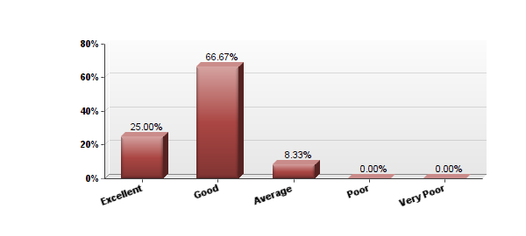
2. How would you rate the clarity of the responsibilities in the job description on the employment website?
# | Answer | Response | %
1 | Excellent | 3 | 25%
2 | Good | 8 | 67%
3 | Average | 1 | 8%
4 | Poor | 0 | 0%
5 | Very Poor | 0 | 0%
 | Total | 12 | 100%
Notes:
MOST RESPONDENTS RATED THE CLARITY OF THE RESPONSIBILITIES IN THE JOB DESCRIPTION GOOD
Out of 12 surveyed a total of 12 responded to the question #2
1 rated the job description as AVERAGE.
RECOMMENDATOIN: Add follow up questions to next years survey. Why was the the description poor? what could be improved upon?

Slide 5
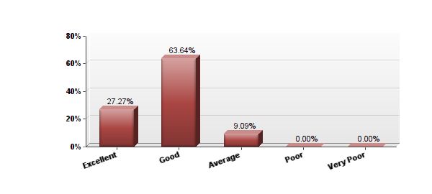
3. How would you rate the effectiveness of the advertisement (website,email blast, job fair etc.)?
# | Answer | Response | %
1 | Excellent | 3 | 27%
2 | Good | 7 | 64%
3 | Average | 1 | 9%
4 | Poor | 0 | 0%
5 | Very Poor | 0 | 0%
 | Total | 11 | 100%
Notes:
MOST RESPONDANTS THOUGHT THAT THE EFFECTIVNESS OF THE ADVERTISMENT WAS GOOD
Out of 12 surveyed a total of 11 responded to the question. Of the 11 respondents that answered:
-3 rated the advertisement as EXCELLENT
-7 rated the advertisement as GOOD
-1 rated the advertisement as AVERAGE
----- Meeting Notes (10/20/14 11:56) -----
comment on the fact that only 11 answered this question.
RECOMMENDATION: for no response of comment.
add a sixth row. Total 11 out of 12 responded. there was one person that did not address this question.

Slide 6
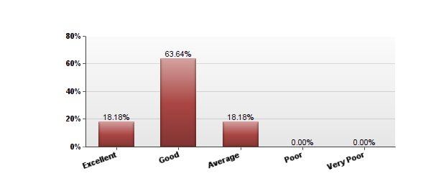
4. How would you rate the information you received during your interview?
# | Answer | Response | %
1 | Excellent | 2 | 18%
2 | Good | 7 | 64%
3 | Average | 2 | 18%
4 | Poor | 0 | 0%
5 | Very Poor | 0 | 0%
 | Total | 11 | 100%
Notes:
MOST RESPONDENTS RATED THE INFO THEY RECEIVED AT THE TIME OF THEIR INTERVIEW AS GOOD
Out of 12 surveyed a total of 11 responded to question #4.
Most respondents rated the info received at their interview as GOOD
- 7 responding Good
----- Meeting Notes (10/20/14 11:56) -----
another missed opportunity to find out why it was only average or what about it was excellent?
RECOMMENDATION: Add more qualitative follow up questions.

Slide 7
ALL STAFF TRAINING

Slide 8
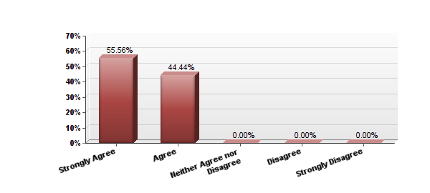
5. The goals and objectives of the training were explained and were clear to me at the beginning of the training session.
# | Answer | Response | %
1 | Strongly Agree | 5 | 56%
2 | Agree | 4 | 44%
3 | Neither Agree nor Disagree | 0 | 0%
4 | Disagree | 0 | 0%
5 | Strongly Disagree | 0 | 0%
 | Total | 9 | 100%
Notes:
ALL agreed that GOALS AND OBJECTIVES WERE CLEAR at the beginning of training.
OF THE 12 SURVEYED only 9 responded to question #5. 4 people did not respond to the question..
RECOMMENDATION: a 6TH column for those who choose not to answer because not having an answer throws off the the true value of the data***

Slide 9
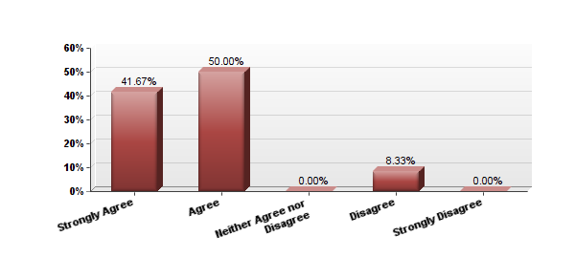
6. The objectives of the training were completed and I was able to acquire the necessary knowledge and skills
# | Answer | Response | %
1 | Strongly Agree | 5 | 42%
2 | Agree | 6 | 50%
3 | Neither Agree nor Disagree | 0 | 0%
4 | Disagree | 1 | 8%
5 | Strongly Disagree | 0 | 0%
 | Total | 12 | 100%
Notes:
MOST agreed that the goals and Objectives were met
only 1 whom DIAGREE’s
----- Meeting Notes (10/20/14 11:56) -----
RECOMMENDATION: Add a qualitative follow up question option for why they disagreed.

Slide 10
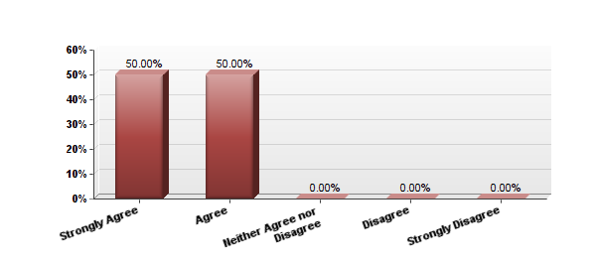
7. I was satisfied with the training material and I was able to comprehend it easily.
# | Answer | Response | %
1 | Strongly Agree | 6 | 50%
2 | Agree | 6 | 50%
3 | Neither Agree nor Disagree | 0 | 0%
4 | Disagree | 0 | 0%
5 | Strongly Disagree | 0 | 0%
 | Total | 12 | 100%
Notes:
ALL participants were satisfied with training materials
of the 12 surveyed, 12 responded to the prompt, “I was satisfied with the training material and I was able to comprehend it easily”.

Slide 11
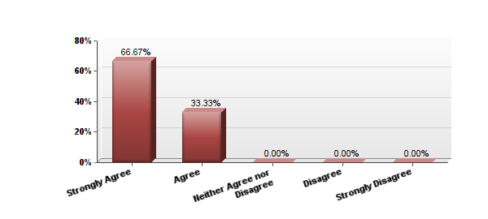
8. The instructor's presentations positively impacted my understanding of training materials
# | Answer | Response | %
1 | Strongly Agree | 8 | 67%
2 | Agree | 4 | 33%
3 | Neither Agree nor Disagree | 0 | 0%
4 | Disagree | 0 | 0%
5 | Strongly Disagree | 0 | 0%
 | Total | 12 | 100%
Notes:
ALL PARTICIPANTS AGREED THAT: PRESENTATIONS Positively impacted understanding of training materials.

Slide 12
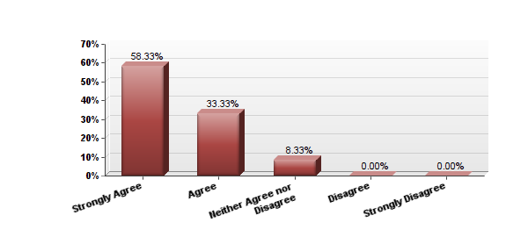
9. The materials distributed were pertinent and useful
# | Answer | Response | %
1 | Strongly Agree | 7 | 58%
2 | Agree | 4 | 33%
3 | Neither Agree nor Disagree | 1 | 8%
4 | Disagree | 0 | 0%
5 | Strongly Disagree | 0 | 0%
 | Total | 12 | 100%
Notes:
MOST agreed that: Training materials were useful
- I NEITHER AGREED NOR DISAGREED
----- Meeting Notes (10/20/14 11:56) -----
need feedback for this slide on whether they agreed or disagreed.

Slide 13
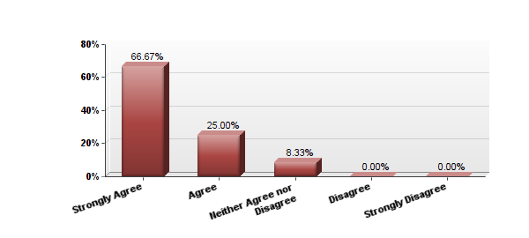
10. I was given ample opportunity to ask questions regarding my employment
# | Answer | Response | %
1 | Strongly Agree | 8 | 67%
2 | Agree | 3 | 25%
3 | Neither Agree nor Disagree | 1 | 8%
4 | Disagree | 0 | 0%
5 | Strongly Disagree | 0 | 0%
 | Total | 12 | 100%
Notes:
MOST agreed that: Participants were given opportunity to ask questions regarding employment
(SAY HOW I DISAGREE THS STATEMENT).
-1 person neither agreed nor disagreed

Slide 14
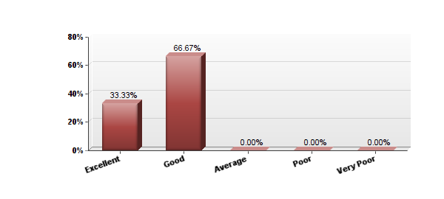
11. After completing staff training, I feel that my knowledge regarding my role, potential liabilities and UB policy is:
# | Answer | Response | %
1 | Excellent | 4 | 33%
2 | Good | 8 | 67%
3 | Average | 0 | 0%
4 | Poor | 0 | 0%
5 | Very Poor | 0 | 0%
 | Total | 12 | 100%
Notes:
MOST participants felt their knowledge regarding their role after training was GOOD.

Slide 15
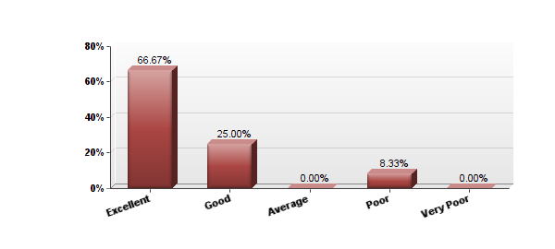
12. After completing staff training, I feel that my knowledge regarding UB’s mission, and the programs model and objectives is:
# | Answer | Response | %
1 | Excellent | 8 | 67%
2 | Good | 3 | 25%
4 | Average | 0 | 0%
6 | Poor | 1 | 8%
7 | Very Poor | 0 | 0%
 | Total | 12 | 100%
Notes:
Following the training, MOST agreed their knowledge regarding UB was: EXCELLENT
- 1 PARTICIPANT THOUGHT IT WAS POOR

Slide 16
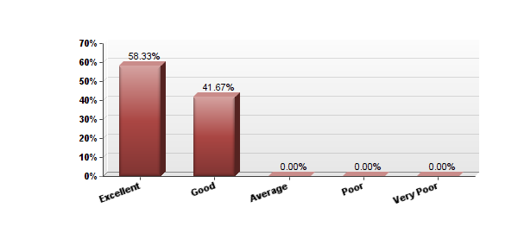
13. The appropriateness of the pace at which course materials and quizzes were covered was:
# | Answer | Response | %
1 | Excellent | 7 | 58%
2 | Good | 5 | 42%
5 | Average | 0 | 0%
6 | Poor | 0 | 0%
7 | Very Poor | 0 | 0%
 | Total | 12 | 100%
Notes:
MOST thought the pace of the training was: EXCELLENT

Slide 17
14. **Overall, which parts of the training were most beneficial to you and which were least beneficial?
Notes:
**See appendix for responses
Of the 12 surveyed ___ responded to question #14
MOST thought the best parts of Training were: “Learning From Returning UB Staff and Diversity / Assumptions Activity”
Most Beneficial:
-4 responded that the MOST beneficial was TALKING and INTERACTING with returning UB staff and learning from their experiences
2 responded that MOST beneficial was Diversity and Assumptions Activity
-1 responded that MOST beneficial was BEING SHOWN WHERE THINGS ARE
-1 responded that MOST beneficial was learning about ROUTINES and PROCEDURES
-1 responded that MOST beneficial was PPT’s
1 responded that MOST beneficial was LIABILITY TRAINING
1 responded that MOST beneficial was DIRECTORS TALK
1 responded that MOST beneficial was Learning about RULES and REGULATIONS
LEAST Beneficial:
Background info (1)
Too much to cover, too long (1)
Over reliance on PPt’s (1)

Slide 18
15. **Is there anything you would like to know that wasn’t explained in the training? If so, please describe below:
Notes:
See appendix for responses
SOME students said they would like more info on Disciplinary Policies and Mandated Reporting …MOST said, NO
-ONLY TWO RESPONDED THAT THEY WOULD LIKE MORE INFORMATOIN
7 of the 9 Surveyed replied that they “did not have any questions at this time”
1 answered that would like more info on mandated reporting and what type of scenarios are reportable.
1 answered that they would like more info regarding disciplinary procedures

Slide 19
TUTOR BREAKOUT TRAINING

Slide 20
1. Name 2-3 areas of the training that were useful to you?
Notes:
Out of 9 surveyed a total of 8 responded to the question Of the 7 respondents:
MOST said the areas of training that were most useful were 1.) skits, mock situations and scenarios 2.) Understanding roles, responsibility
-3 expressed that the most useful areas of training were understanding roles, responsibilities, and expectations.
-4 expressed that the most useful areas of training were the "skits", "mock situations" and "scenarios”
-1 expressed that the most useful areas of training were drawing from the experiences of returning UB staff.
-1 expressed that the most useful areas of training were liability
-1 expressed that the most useful areas of training were authority
-1 expressed that the most useful areas of training was the previous tutor log.-1 expressed that the most useful areas of training was the diversity activity
-I expressed that training should have taken place before the student orientation.

Slide 21
2. Name 2-3 areas of the training that could use improvement?
Notes:
Out of 9 surveyed a total of 8 responded to the question. Of the 7 respondents:
MOST said areas that could use improvement were 1.) More interactive 2.) Too long
4 expressed that the training could be more interactive
-3 expressed that the training was too long
-1 expressed that the off-task procedures could be improved-1 expressed that there was too much paperwork
-1 expressed that the snacks could be improved
-1 recommended that the ppt's be made available for review prior to training day
-1 expressed that everything about the training was excellent
- 1 expressed that the portion of the training with students as well as the introduction / program overview could be improved.

Slide 22
3. What information do you think would be useful for you to do your job better?
Notes:
Out of 8 whom replied to the survey a total of 8 answered question #3
MOST responded that a better job could have been done at 1.) review of each student's academic background 2 Reviewing each students personal background
-2 expressed that they thought it would be useful to review how each student is doing academically
-1 expressed that they thought it would be useful to have more information on busing and tracking
-2 expressed that they thought it would be useful to review students personal background
-1 expressed that they though it would be useful to review any behavioral concerns
- 1 expressed that they thought it would be useful review a description of roles of the professional staff.

Slide 23
RECAP
1. 4 were office staff -6 were tutors -2 were teaching staff
2. MOST RESPONDANTS RATED THE CLARITY OF THE RESPONSIBILITIES IN THE JOB DESCRIPTION GOOD
3. MOST RESPONDANTS THOUGHT THAT THE EFFECTIVNESS OF THE ADVERTISMENT WAS GOOD 4. MOST RESPONDENTS RATED THE INFO THEY RECEIVED AT THE TIME OF THEIR INTERVIEW AS GOOD
5. ALL agreed that GOALS AND OBJECTIVES WERE CLEAR at the beginning of training
6. MOST agreed that the goals and Objectives were met
7. ALL participants were satisfied with training materials
8. ALL PARTICIPANTS AGREED THAT: PRESENTATIONS Positively impacted their understanding of materials.
9. MOST agreed that: Training materials were useful
10. MOST agreed that: Participants were given opportunity to ask questions regarding employment
11. MOST participants felt their knowledge regarding their role after training was GOOD.
12. Following training MOST agreed their knowledge regarding UB was: EXCELLENT
13. MOST thought the pace of the training was: EXCELLENT
14. MOST thought the best parts of Training were: “Learning From Returning UB Staff and Diversity / Assumptions Activity”
15. SOME students said they would like more info on Disciplinary Policies and Mandated Reporting …MOST said, NO
MOST said the areas of training that were most useful were 1.) skits, mock situations and scenarios 2.) Understanding roles, responsibility
MOST said areas that could use improvement were a.) More interactive b.) Too long
3. MOST responded that a better job could have been done of: a). review of each student’s academic background b.) Reviewing each students personal background

Slide 24
Notes:
Questions?

